Slide 1
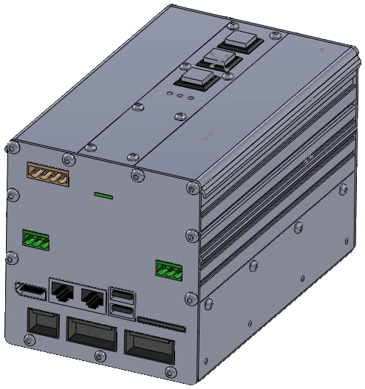
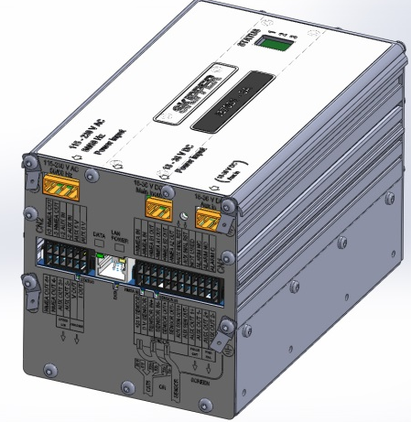
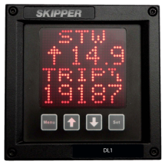
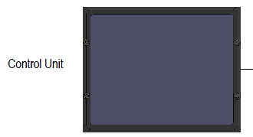
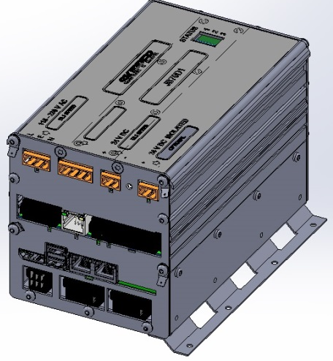
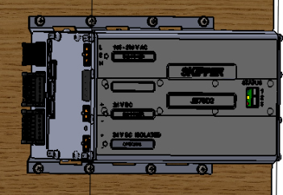
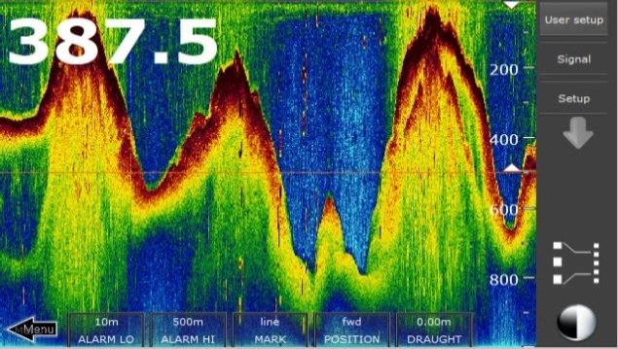
The Multi Series
The DL1-Multi
SKIPPER Electronics AS
Enebakkveien 150
0680 Oslo
www.skipper.no
Tlf. +47 23 30 22 70
Fax +47 23 30 22 71
sales@skipper.no
support@skipper.no

Slide 2
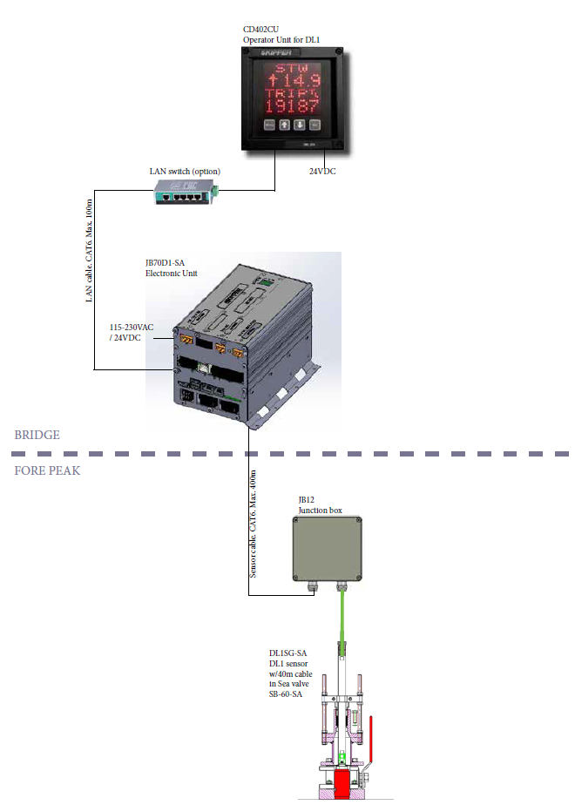
DL1 Multi
DL1 Multi. Navigational speed log.
1 axis STW.
DL1 Multi is the first product in a new series of speed log and echo sounder products.
The new series is developed around a new electronic unit JB70.
It features modern LAN communication and web setup in addition to all required I/O’s.
SKIPPER Electronics AS
Enebakkveien 150
0680 Oslo
www.skipper.no
Tlf. +47 23 30 22 70
Fax +47 23 30 22 71
sales@skipper.no
support@skipper.no

Slide 3
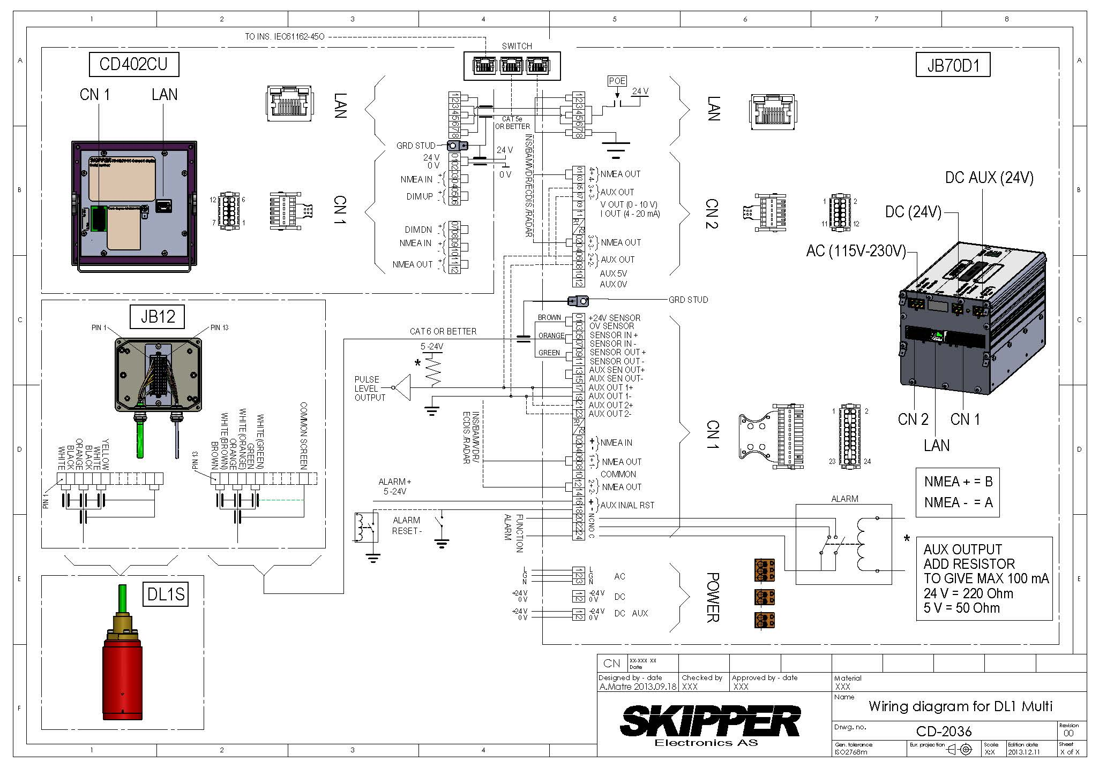
DL1 Connection
ADD picture and connection of connector and AUX
SKIPPER Electronics AS
Enebakkveien 150
0680 Oslo
www.skipper.no
Tlf. +47 23 30 22 70
Fax +47 23 30 22 71
sales@skipper.no
support@skipper.no

Slide 4
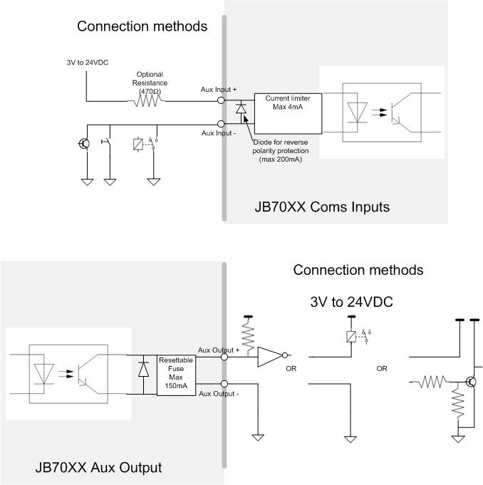
Auxiliary Connection
SKIPPER Electronics AS
Enebakkveien 150
0680 Oslo
www.skipper.no
Tlf. +47 23 30 22 70
Fax +47 23 30 22 71
sales@skipper.no
support@skipper.no

Slide 5
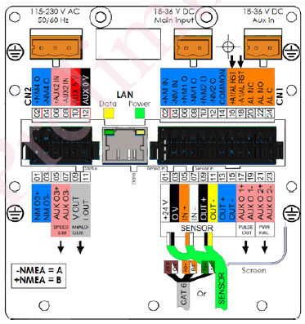
JB70D1-SA
Dual Power supply
I/O Multi extension PCB
SKIPPER Electronics AS
Enebakkveien 150
0680 Oslo
www.skipper.no
Tlf. +47 23 30 22 70
Fax +47 23 30 22 71
sales@skipper.no
support@skipper.no

Slide 6
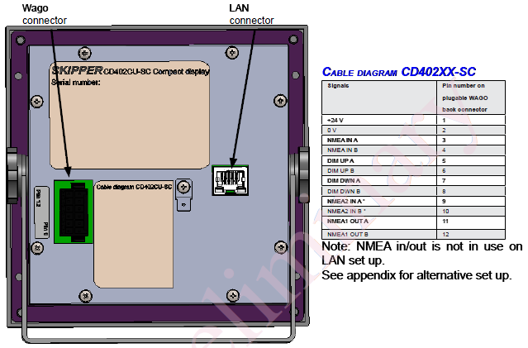
CD402CU-SC
SKIPPER Electronics AS
Enebakkveien 150
0680 Oslo
www.skipper.no
Tlf. +47 23 30 22 70
Fax +47 23 30 22 71
sales@skipper.no
support@skipper.no

Slide 7
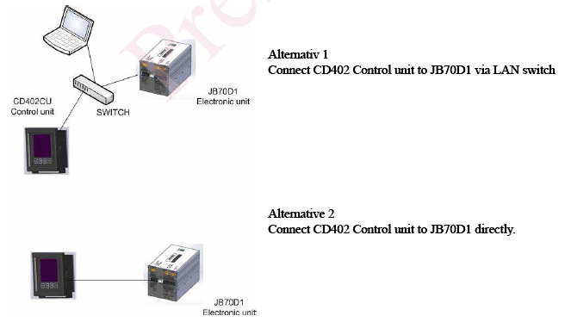
Optional LAN switch for setup from PC
SKIPPER Electronics AS
Enebakkveien 150
0680 Oslo
www.skipper.no
Tlf. +47 23 30 22 70
Fax +47 23 30 22 71
sales@skipper.no
support@skipper.no

Slide 8
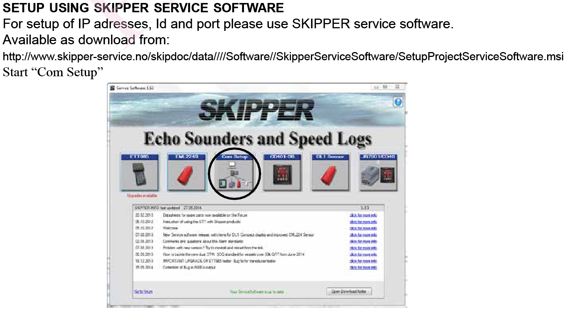
SKIPPER Electronics AS
Enebakkveien 150
0680 Oslo
www.skipper.no
Tlf. +47 23 30 22 70
Fax +47 23 30 22 71
sales@skipper.no
support@skipper.no

Slide 9
DL1 Setup using the Web pages
The DL1-Multi has 2 boxes:
The CD402CU
  A dot matrix control unit, with local 24V that gets a bit map sent from the Electronic unit. And sends all button presses via LAN or Network
The JB70D1
  The brains of the system, providing the IO to the bridge and information to the user control unit
  Both units have an IP address, and support the IEC61162-450 Light ethernet standard
SKIPPER Electronics AS
Enebakkveien 150
0680 Oslo
www.skipper.no
Tlf. +47 23 30 22 70
Fax +47 23 30 22 71
sales@skipper.no
support@skipper.no

Slide 10
  IEC61162-450 Light ethernet standard
The Standard is designed to send NMEA style messages over internet.
Broadcast- All systems on the network can see the messages
      Groups are provided to limit the amount of messages the input has to look at
Point to point – Each system has a unique identity (VD1234)
      Each message can be sent from and to, or to everyone.
      The DL1-Multi screen and electronics box are ‘paired’ to each other and send proprietry messages at 2 Hz.
Alarms – Alarms have a similar point to point system
      new alarm messages for INS (IEC61924) standard
SKIPPER Electronics AS
Enebakkveien 150
0680 Oslo
www.skipper.no
Tlf. +47 23 30 22 70
Fax +47 23 30 22 71
sales@skipper.no
support@skipper.no

Slide 11
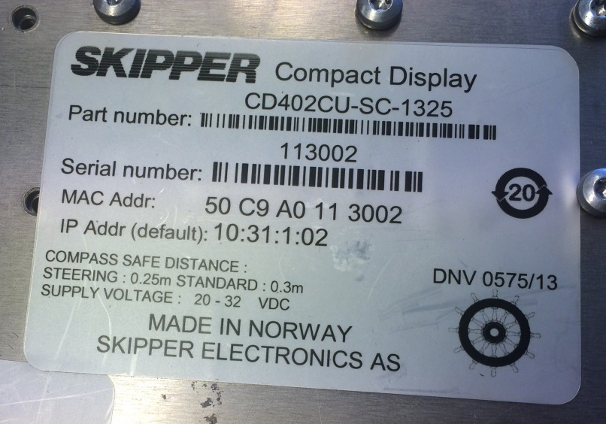
DL1 Setup using the Web pages
To get to the web page you need a browser
  Direct cable axis – PC must be set to a static IP address, similar to the Box IP address
  Through a switch , just type the IP address in the browser
The DL1-Multi units have IP addresses with a number similar to the serial number. Printed on serial number.
Once in the Web page the system can be set up and paired.
It is possible to pair more than 1 display to the unit.
SKIPPER Electronics AS
Enebakkveien 150
0680 Oslo
www.skipper.no
Tlf. +47 23 30 22 70
Fax +47 23 30 22 71
sales@skipper.no
support@skipper.no

Slide 12
  Using The DL1-Multi
Setup IO
Calibrate (quick)
  No heading calibration on 1 Axis. It must be correct
  Single high speed calibration often enough
Calibrate (Sea test)
  Single high speed calibration often enough
Other special features for DL1-Multi
  Ping size
    Standard says measure within first 3 meters under the vessel (2ms) –
    Can be extended to 8ms(12m) for higher resolution and more stability, but may cross a layer.
SKIPPER Electronics AS
Enebakkveien 150
0680 Oslo
www.skipper.no
Tlf. +47 23 30 22 70
Fax +47 23 30 22 71
sales@skipper.no
support@skipper.no

Slide 13
Other special features for DL1-Multi
  Built in test.
    There are 10 tests some require special loop plugs
    1-4 are internal tests Electronics and communication to the sensor
    Test 5-9 are factory tests, but can be checked in the filed by making connectors that loop inputs to outputs
    Test A is a Raw input monitor theat monitors the input from the sensor. $PSKPDAT,1,FWD,Q,AFT,Q,Temp,XXX,YYY,ZZZ*nn
  It shows a fwd speed (unscaled) and its quality 1-8 >3 is ok but normally 8
  It shows a Aft speed (unscaled) and its quality 1-8 >3 is ok but normally 8
  It checks if these meet quality parameters (these should be close to the same but in opposite directions)
SKIPPER Electronics AS
Enebakkveien 150
0680 Oslo
www.skipper.no
Tlf. +47 23 30 22 70
Fax +47 23 30 22 71
sales@skipper.no
support@skipper.no

Slide 14
Other special features for DL1-Multi
  Sensor alarm
    If the sensor detects a failure of communications or some critical component it will send a sensor alarm
      If the control unit is not communicating – ERROR on screen with flashing dot
      If control unit freezes – dot stops flashing
      ??If electronic unit freezes – dot stops flashing 10 seconds ,and then ERROR after some time and dot restarts
      If sensor quality is too low. The NMEA output and screen will show . . . .
      If communication to the system is bad then ---- for checksum error
      If there is no input where expected each individual line will read ERROR
SKIPPER Electronics AS
Enebakkveien 150
0680 Oslo
www.skipper.no
Tlf. +47 23 30 22 70
Fax +47 23 30 22 71
sales@skipper.no
support@skipper.no

Slide 15
Other special features for DL1-Multi
  Simulate a speed
    The sensor can be made to run a DEMO mode where the user selects a speed, and the system runs it from sensor to display.
      Set the speed and press set (or run from web)
      The Sensor sends a frequency from 1 transducer to the other, and back, and measures the signal
      This will test the transmitter, the receiver and all system parts. Water is not needed.
  SKIPPER Service software
    Check what is connected
    Quick set up
    Check the sensor messages directly
    Check the raw data of the sensor.
      Test if your installation is optimal (Noise floor)
      Test if your signal strength is strong enough
SKIPPER Electronics AS
Enebakkveien 150
0680 Oslo
www.skipper.no
Tlf. +47 23 30 22 70
Fax +47 23 30 22 71
sales@skipper.no
support@skipper.no

Slide 16
Other special features for DL1-Multi
  The Web page
    To use some parts of the web page you need to enter the service password ‘service’
    All can be changed and set up
    Calibration can be run from here if required
    Diagnostics of power supplies
    Set up of communications
SKIPPER Electronics AS
Enebakkveien 150
0680 Oslo
www.skipper.no
Tlf. +47 23 30 22 70
Fax +47 23 30 22 71
sales@skipper.no
support@skipper.no

